Slide 1

Ukraine-Russia on Twitter: Network Analysis of Influencers and Bots
By:
James Anderson
Parthiv Borgohain
Rishabh Tiwari
Saurabh Arora
Shubhada Kapre

Slide 2

Agenda
Data Collection and Description
Bot Detection Model
Networks
Topic Modelling
Insights
Conclusion and Recommendations

Slide 3



Data Collection
Scraped 13k tweets with the following 9 hashtags:
"#Russia"
"#Ukraine"
"#RussianUkrainianWar"
"#UkraineWar"
"#UkraineRussianWar"
"#RussiaIsANaziState"
"#SlavaUkraïni"
"#UkraineRussiaWar","#RussiaUkraineWar"

Slide 4




Likes
Retweets
Followers
Following
0.36 Likes per Tweet
1.7k following per User
88 Retweets per User
47K followers per User

Slide 5
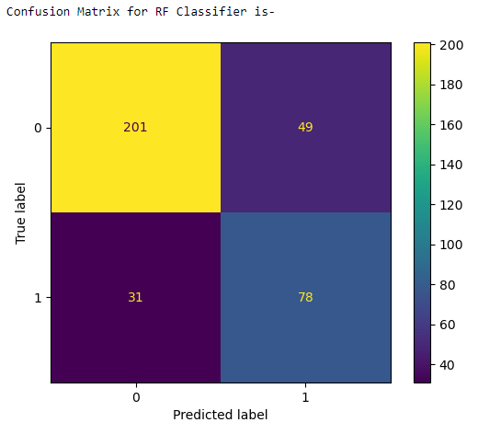
Bot Detection
Acquired a dataset from Kaggle containing 2 columns: "id" and a mechanical turk-based assessment of bot/human classification.
Leveraged the Tweepy library to scrape information on approximately 2000 Twitter accounts.
Decision variables include following, followers, and source of account.
Developed and trained a random forest classification model with max_depth=2, random_state= 0 to distinguish between bots and humans.
Model returned 77.7% accuracy on the test set.
Applied the trained bot model to analyze the scraped Russia-Ukraine network users' information and accurately classify each user as either bot or human.

Slide 6
Influencers
Bots
Often includes links
Prolific use of hastags & unique mention
Multiple subjects in the tweet
One subject on the tweet
Pathos often referenced
"RT @igorsushko: #Russia: Bread line ðŸž of Ukrainians who weren't imprisoned or executed in fascist-occupied #Mariupol.
Welcome to Russkiy Mâ€¦"
@RaufHabibov @sandumaiamd @EmmanuelMacron @NATO Macron's favorite courtesan #Armenia is #Iran regime's friend, whoâ€¦ https://t.co/2Zv98il0F3
RT @GeorgeSirdar: Putin says 95% of Global Terrorism is done by the CIA
#Russia #Iran #India #Putin #USA #Biden #Germany #NATO #Ukraine #â€¦
"RT @nexta_tv: The #US President to visit #Poland on February 20-22, White House says
Earlier, Polish authorities said they had sent Joe Biâ€¦"
18.1% of tweets were produced by accounts classified as bots.
17.2% of users in the network were classified as bots.
Our original data set had 2.3 hashtags per tweet. The dataset filtered to contain bots only had 2.9 hashtags per tweet. No considerable difference in the number of mentions, but the type of mentions used by bots was pecuiliar.

Slide 7
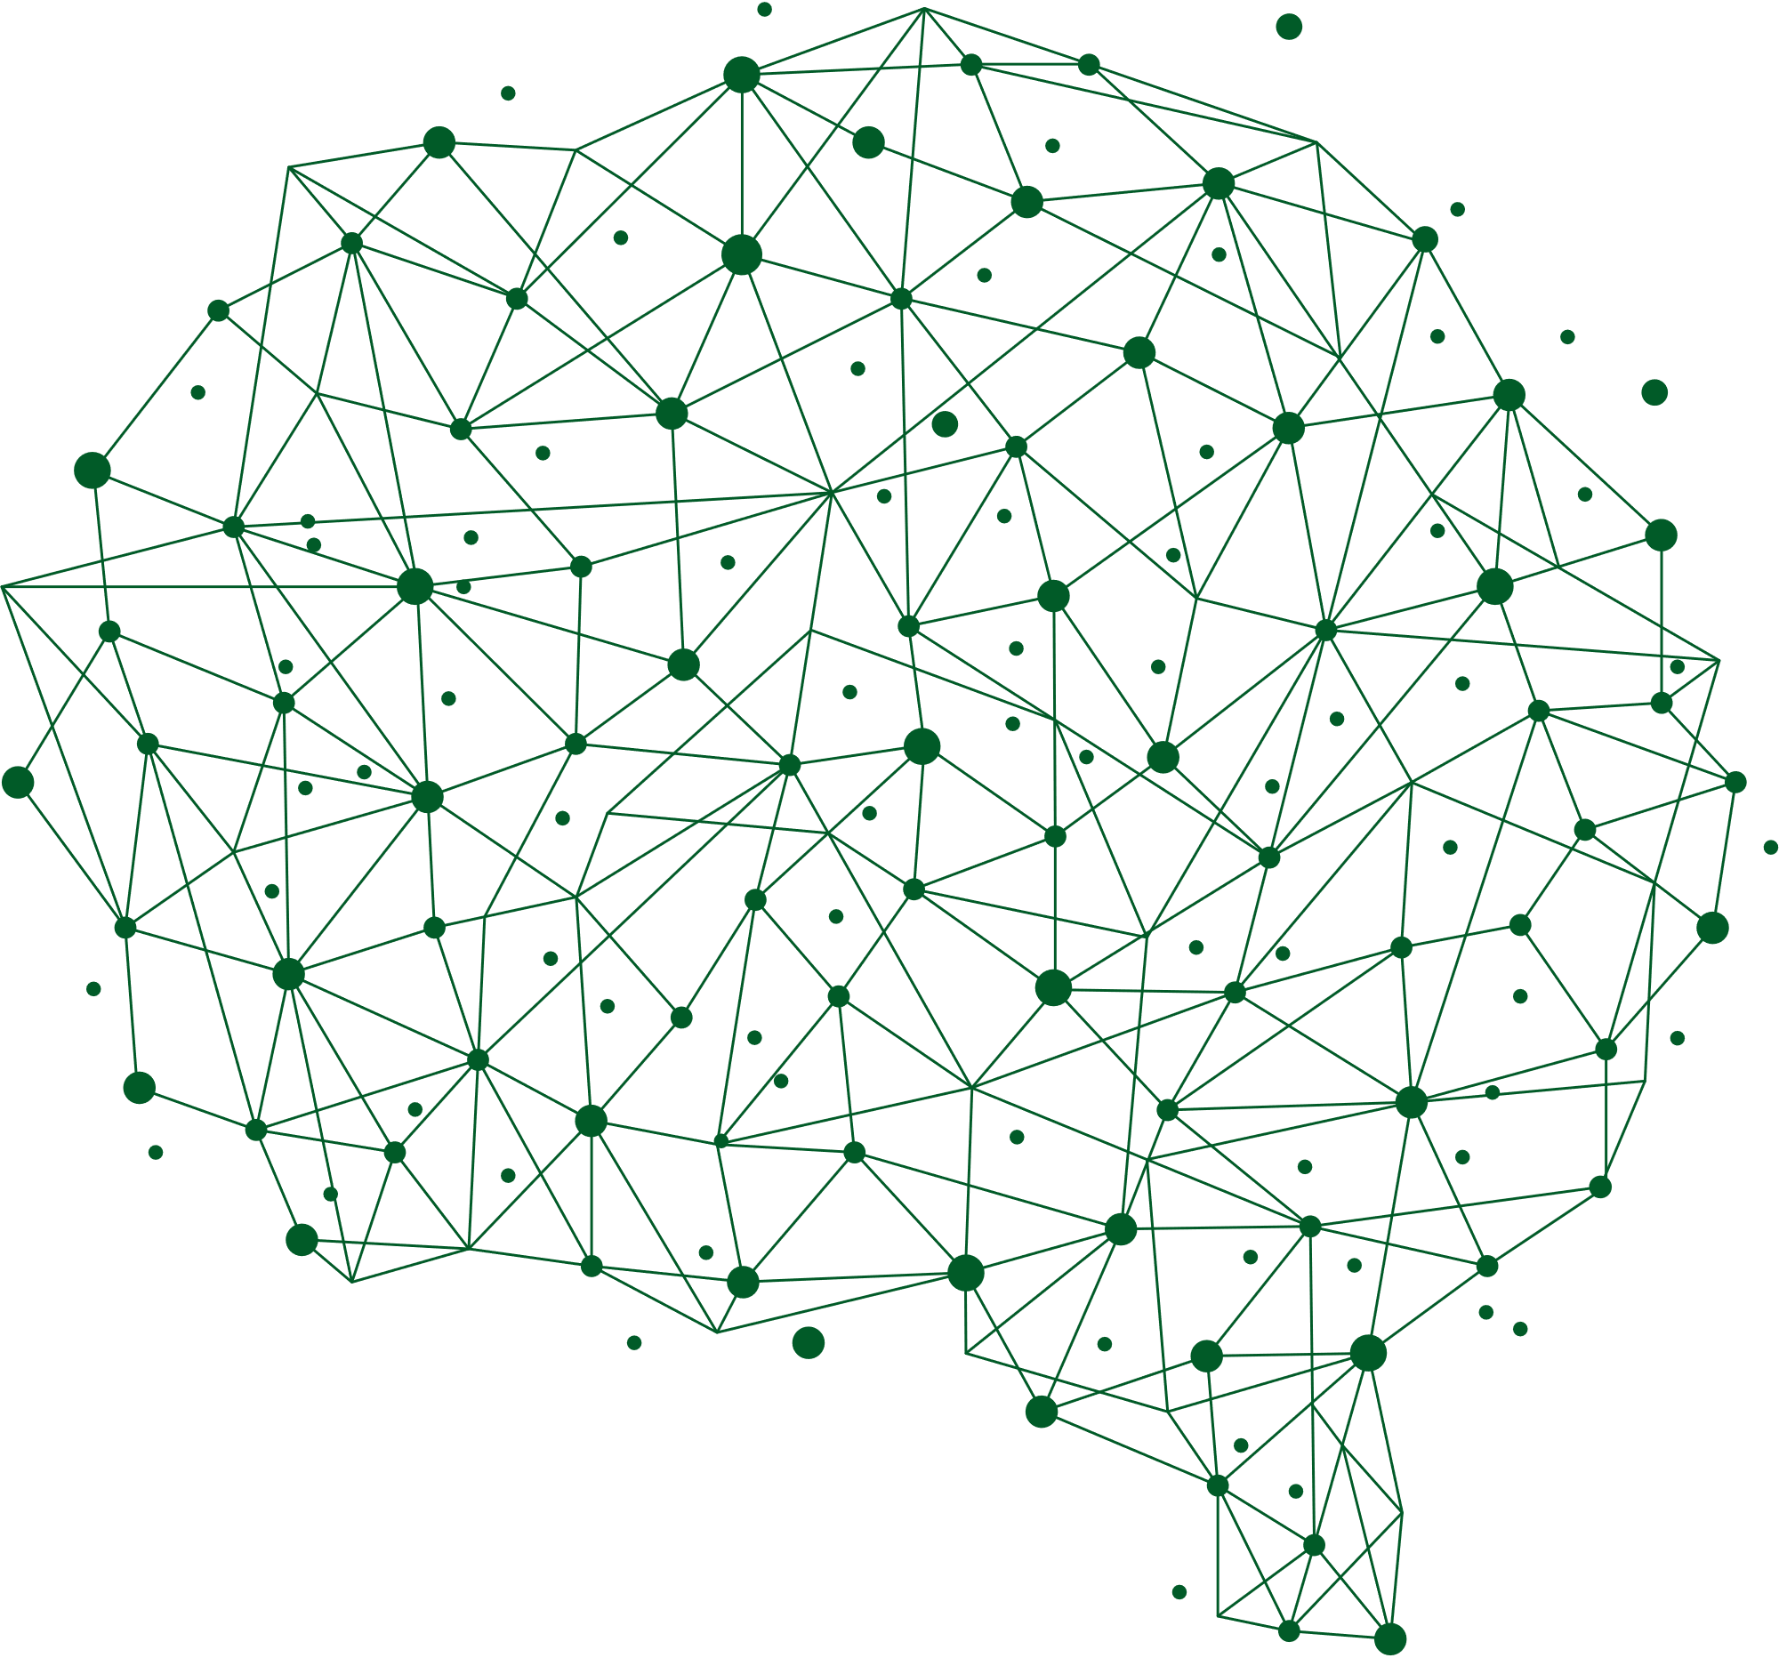
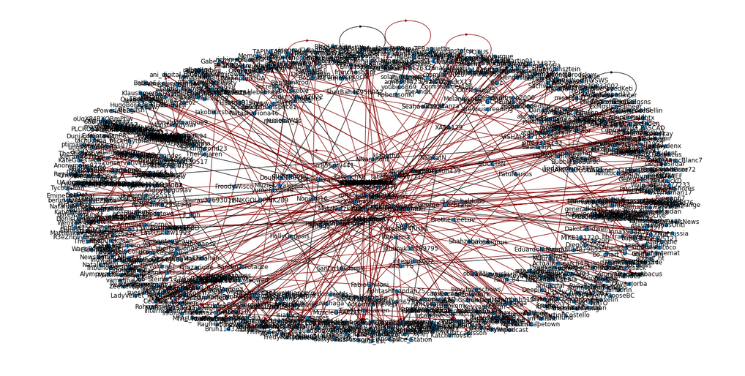
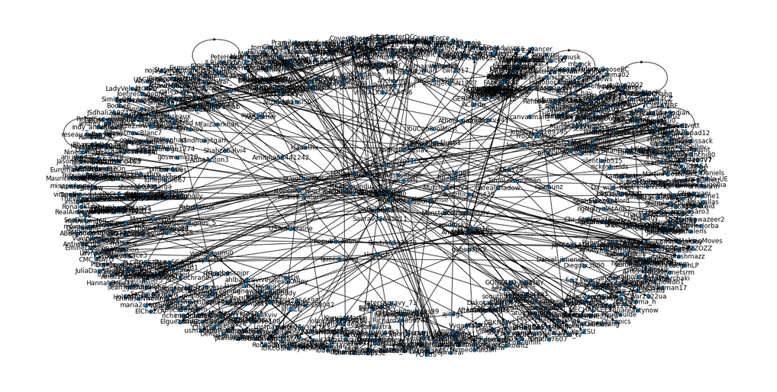
Networks with Bots
The left network represents the entire network with bot accounts highlighted in dark red, while the right network is the same network with all bot accounts removed. Despite the removal of bot accounts, the right network remains fairly dense, suggesting that it is self-sustaining. This contradicts the conventional narrative that bots are solely responsible for shaping the narrative of the Russia-Ukraine propaganda network, as our analysis suggests that the network is driven by both human and bot accounts.

Slide 8

Topic Modelling
Topic 1
Topic 2
Topic 3
News:
General War & Hashtags
Russian Embassy
(ukrainewar, ukrainewillwin, ukrainerussianwar, ukrainerussiawar, slavaukraini, russianukrainianwar, war, forces)
Some topics that we got were as follows: embassyofrussia, mfa_russia, russian_consulate, rusmission_eu, russianembassy
words near topic: https, co, watch, pm , abpnews)
Topic Modeling for bots only did not return topic 3... Are bots not focused on "breaking news"?

Slide 9
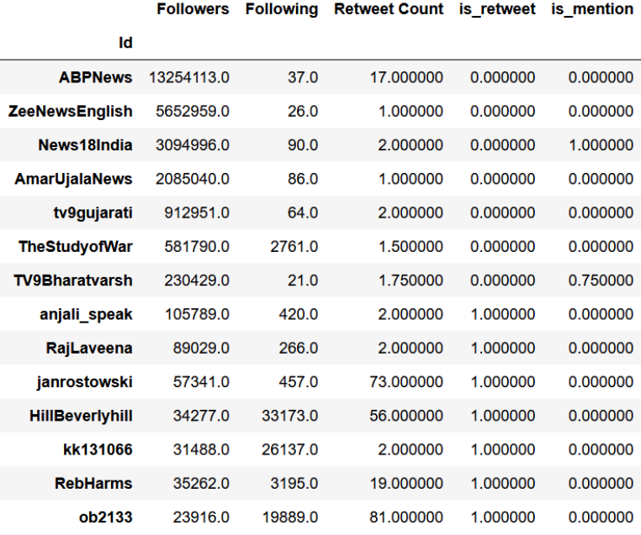
Top Influencers
Based on our previous influence score model, we assigned a score to every user based on their attributes like no. of followers, retweets, network metrics etc. Then we tried to analyze the Top 15 influencers as per this score
Out of the 15 accounts we analyzed, 6 were Indian news channels, 1 was a political think-tank, and the remaining accounts were journalists and politicians.
After conducting a preliminary analysis, we found that none of these accounts appeared to be bots.
Upon initial inspection, we did not find any evidence to suggest that any of these accounts originated from Russia or Ukraine.

Slide 10
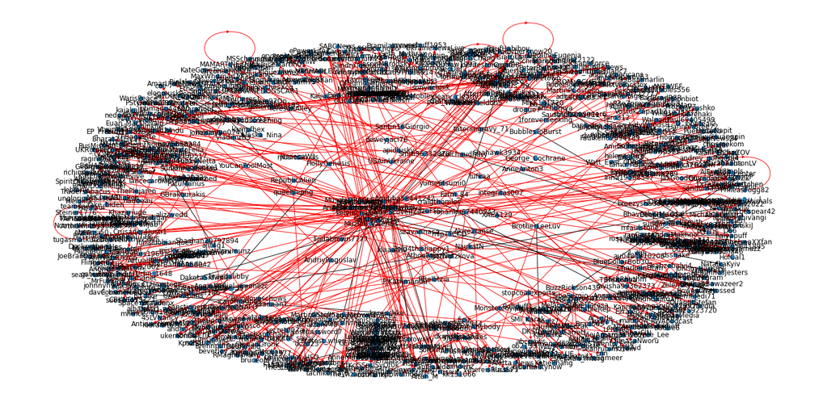
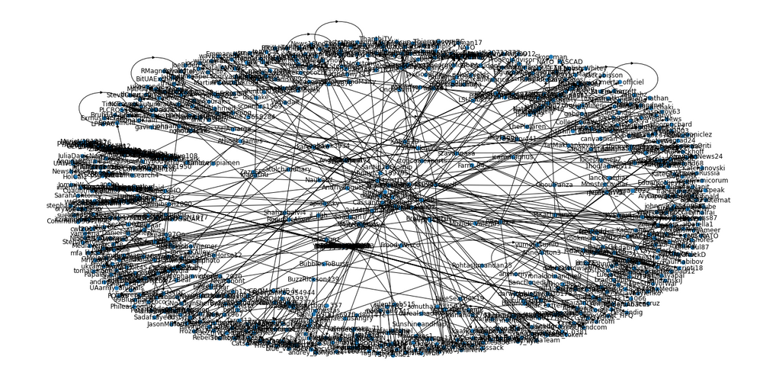
Network with Influencers
In the image on the left, we can see the entire network. The edges associated with the top influencers are highlighted in red. However, by removing the top 30 most influential users according to our model, we obtain the network on the right. Notably, we observe that the network remains highly dense, suggesting that it is self-sustaining. As a result, it is unlikely that solely going after bot accounts will not significantly impact the overall network and the prevailing narrative

Slide 11

Conclusion
18.1% of tweets were produced by accounts classified as bots.
Bots generally talk about the same subject matter as non-bots, however, they tend to not focus on “breaking news” (embassy example). Isolated incident
May be able to add more parameters to the bot classifier. Add avg. number of mentions/hashtags used
Topic Modeling showed a variety of related hashtags
The Russia-Ukraine Network is self-sustaining. So, it is difficult to control the narrative by solely focusing on a few influencer accounts.
Although a decent proportion of accounts seem to be bot accounts, they do not hold as much sway as the prevailing narrative regarding Russian bots seems to suggest
Top influencers did not appear to originate from Russia or Ukraine

Slide 12


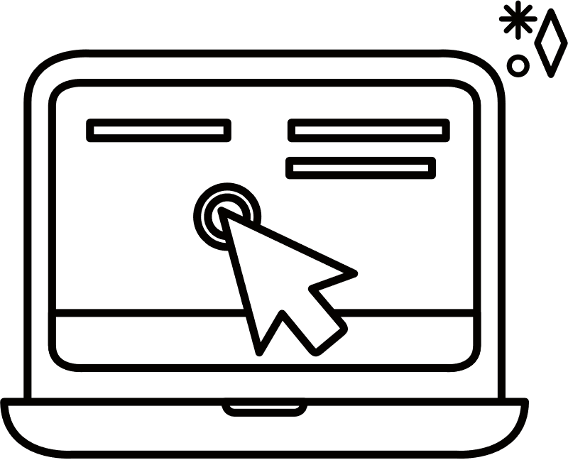
Recommendations
Self Sustaining Network
The network is self-sustaining. There is limited use to target influencers or bring more influencers into the network. Aside from there being the obvious ethical implications of the above.
Improve Bot Detection Software
Bot identification may be supplemented by topic modeling. named Entity Recognition, frequency of hashtags/mentions. Posing additional verification using a reCaptcha or other bot-prevention software test to minimizes false positives
Enhancing Search Engine
Use Topic Modeling to aggregate similar hashtags to give more comprehensive results.

